Slide 1

2回目
9ldi1101
徐 恃源

Slide 2
Contents
論文紹介
学習したこと

Slide 3
Explaining Machine Learning Models in Natural Conversations: Towards a Conversational XAI
University of Duisburg-Essen Germany
The goal of Explainable AI (XAI) is to design
methods to provide insights into the reasoning process of blackbox models, such as deep neural networks, in order to explain
them to humans. Social science research states that such explanations should be conversational, similar to human-to-human
explanations. In this work, we show how to incorporate XAI
in a conversational agent, using a standard design for the
agent comprising natural language understanding and generation
components. We build upon an XAI question bank which we
extend by quality-controlled paraphrases to understand the
user’s information needs. We further systematically survey the
literature for suitable explanation methods that provide the
information to answer those questions, and present a comprehensive list of suggestions. Our work is the first step towards
truly natural conversations about machine learning models with
an explanation agent. The comprehensive list of XAI questions
and the corresponding explanation methods may support other
researchers in providing the necessary information to address
users’ demands.
Index Terms—explainable artificial intelligence, XAI, conversational agents, conversational XAI agents
XAIつまり、ブラックボックスの中の過程が人に分かれるようにする説明可能である自然語会話のモデルを作ること

Slide 4
Understanding Natural Language in Context
Technion - Israel Institute of Technology
Recent years have seen an increasing number of applications that have a natural
language interface, either in the form of chatbots or via personal assistants such as
Alexa (Amazon), Google Assistant, Siri (Apple), and Cortana (Microsoft). To use
these applications, a basic dialog between the robot and the human is required.
While this kind of dialog exists today mainly within "static" robots that do not
make any movement in the household space, the challenge of reasoning about the
information conveyed by the environment increases significantly when dealing
with robots that can move and manipulate objects in our home environment.
In this paper, we focus on cognitive robots [9], which have some knowledge-based
models of the world and operate by reasoning and planning with this model. Thus,
when the robot and the human communicate, there is already some formalism they
can use – the robot’s knowledge representation formalism.
Our goal in this research is to translate natural language utterances into this robot’s
formalism, allowing much more complicated household tasks to be completed.
We do so by combining off-the-shelf SOTA language models, planning tools, and
the robot’s knowledge-base for better communication. In addition, we analyze
different directive types and illustrate the contribution of the world’s context to the
translation process.
状況に適する自然語を理解できるようにして、より複雑な作業ができるようにする研究。

Slide 5
Enhancing Semantic Understanding with Self-supervised Methods for Abstractive Dialogue Summarization
AI Research Center, Samsung SDS, South Korea
BERTを使って多量のニュースの記事で訓練させた要約モデルで、抽象的な会話を要約し、抽象画を構築し要約性能の改善を行う。
Contextualized word embeddings can lead to state-of-the-art
performances in natural language understanding. Recently, a
pre-trained deep contextualized text encoder such as BERT has
shown its potential in improving natural language tasks including abstractive summarization. Existing approaches in dialogue
summarization focus on incorporating a large language model
into summarization task trained on large-scale corpora consisting of news articles rather than dialogues of multiple speakers.
In this paper, we introduce self-supervised methods to compensate shortcomings to train a dialogue summarization model. Our
principle is to detect incoherent information flows using pretext
dialogue text to enhance BERT’s ability to contextualize the dialogue text representations. We build and fine-tune an abstractive
dialogue summarization model on a shared encoder-decoder architecture using the enhanced BERT. We empirically evaluate
our abstractive dialogue summarizer with the SAMSum corpus,
a recently introduced dataset with abstractive dialogue summaries. All of our methods have contributed improvements to
abstractive summary measured in ROUGE scores. Through an
extensive ablation study, we also present a sensitivity analysis
to critical model hyperparameters, probabilities of switching utterances and masking interlocutors.

Slide 6
Preprocessing(前処理)

Slide 7
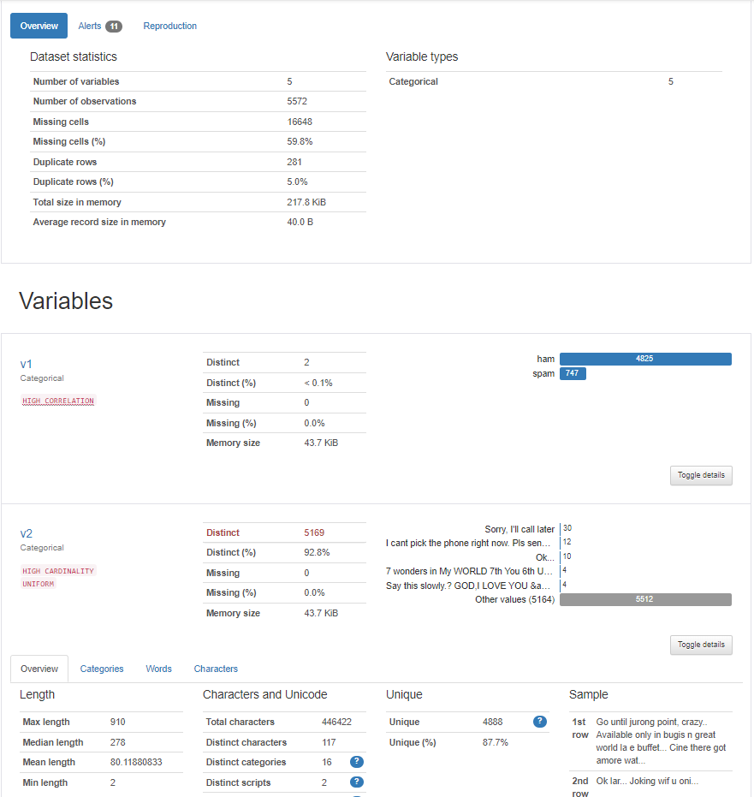
Exploratory Data Analysis
探索的データ解析
pandas-profiling

Slide 8
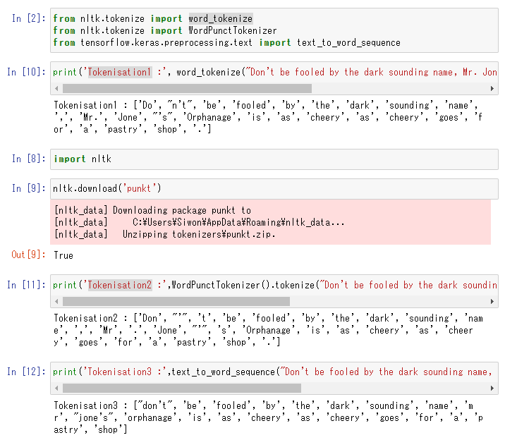
Tokenization
NLTK, Keras
Tokenization ツールの違い
word_tokenize
WordPunctTokenizer
text_to_word_sequence

Slide 9
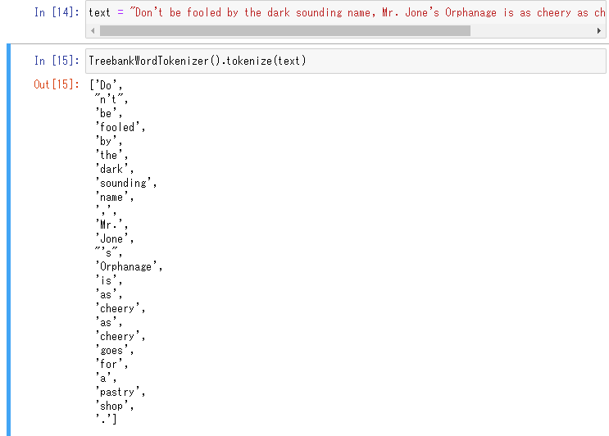
Penn Treebank Tokenization
Tokenizationの標準の一つ。
規則
split standard contractions
treat most punctuation characters as separate tokens
split off commas and single quotes, when followed by whitespace
separate periods that appear at the end of line

Slide 10
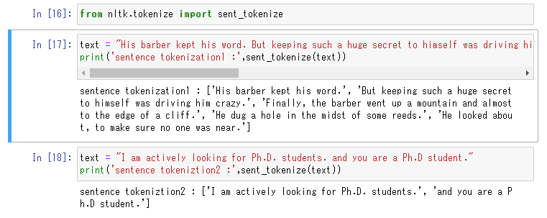
Sentence Tokenization
NLTK
単純にピリオドだけで区別してはいけない。

Slide 11
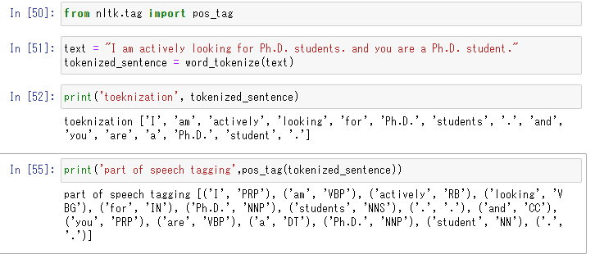
part-of-speech tagging 品詞タギング
NLTK
基準 Penn Treebank POS Tags

Slide 12
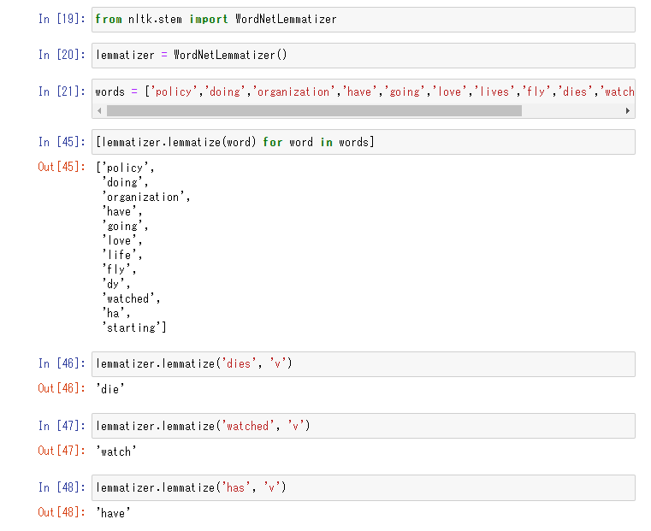
Lemmatization
NLTK
WordNetLemmatizer
Lemma(基本型)を返還する。

